Slide 1



Convolutional Neural Network
Indian Institute of Information Technology, Allahabad
By
Dr. Shiv Ram Dubey Assistant Professor Computer Vision And Biometrics Lab (CVBL) Department Of Information Technology Indian Institute Of Information Technology, Allahabad
Email: srdubey@iiita.ac.in Web: https://profile.iiita.ac.in/srdubey/

Slide 2
Disclaimer
The content (text, image, and graphics) used in this slide are adopted from many sources for Academic purposes. Broadly, the sources have been given due credit appropriately. However, there is a chance of missing out some original primary sources. The authors of this material do not claim any copyright of such material.

Slide 3
Outline
Convolutional Neural Networks (CNNs):
CNN architecture
Different layers
Progress
CNN Architectures for Classification:
AlexNet, VGG, GoogleNet, ResNet
CNN Architectures for Object Detection:
R-CNN, Fast R-CNN, Faster R-CNN, YOLO
CNN Architectures for Segmentation:
U-Net, SegNet, Mask R-CNN
CNN Architectures for Generation:
Pix2Pix, CycleGAN
Most material from CS231n CNN for Visual Recognition course at Stanford

Slide 4

What is Deep Learning (DL) ?
A machine learning subfield of learning representations of data. Exceptional effective at learning patterns.
Deep learning algorithms attempt to learn (multiple levels of) representation by using a hierarchy of multiple layers
If you provide the system tons of information, it begins to understand it and respond in useful ways.
https://www.xenonstack.com/blog/static/public/uploads/media/machine-learning-vs-deep-learning.png

Slide 5
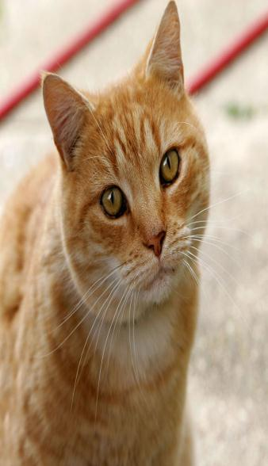

Multi-layer Neural Network & Image
How to apply NN over Image?

Slide 6
Multi-layer Neural Network & Image
Stretch pixels in single column vector

Slide 7
Multi-layer Neural Network & Image
Stretch pixels in single column vector
Problems ?

Slide 8
Multi-layer Neural Network & Image
Stretch pixels in single column vector
Problems:
High dimensionality
Local relationship

Slide 9
Multi-layer Neural Network & Image
Stretch pixels in single column vector
Problems:
High dimensionality
Local relationship
Solution ?

Slide 10
Multi-layer Neural Network & Image
Stretch pixels in single column vector
Problems:
High dimensionality
Local relationship
Solution:
Convolutional Neural Network

Slide 11
Convolutional Neural Networks
Also known as
CNN,
ConvNet,
DCN
CNN = a multi-layer neural network with
1. Local connectivity
2. Weight sharing

Slide 12
CNN: Local Connectivity
Hidden layer
Input layer
Global connectivity
Local connectivity
# input units (neurons): 7
# hidden units: 3
Number of parameters
Global connectivity: ?
Local connectivity: ?

Slide 13
CNN: Local Connectivity
Hidden layer
Input layer
Global connectivity
Local connectivity
# input units (neurons): 7
# hidden units: 3
Number of parameters
Global connectivity: ?
Local connectivity: ?

Slide 14
CNN: Local Connectivity
Hidden layer
Input layer
Global connectivity
Local connectivity
# input units (neurons): 7
# hidden units: 3
Number of parameters
Global connectivity: 3 x 7 = 21
Local connectivity: 3 x 3 = 9

Slide 15
CNN: Weight Sharing
Hidden layer
w₁
w₃
w₅
w₇
w₉
w₁
w₃
w₂
w₁
w₃
w₂
w₄
w₆
w₈
w₂
w₁
w₃
w₂
Input layer
Without weight sharing
With weight sharing
# input units (neurons): 7
# hidden units: 3
Number of parameters
Without weight sharing: ?
With weight sharing : ?

Slide 16
CNN: Weight Sharing
Hidden layer
w₁
w₃
w₅
w₇
w₉
w₁
w₃
w₂
w₁
w₃
w₂
w₄
w₆
w₈
w₂
w₁
w₃
w₂
Input layer
Without weight sharing
With weight sharing
# input units (neurons): 7
# hidden units: 3
Number of parameters
Without weight sharing: ?
With weight sharing : ?

Slide 17
CNN: Weight Sharing
Hidden layer
w₁
w₃
w₅
w₇
w₉
w₁
w₃
w₂
w₁
w₃
w₂
w₄
w₆
w₈
w₂
w₁
w₃
w₂
Input layer
Without weight sharing
With weight sharing
# input units (neurons): 7
# hidden units: 3
Number of parameters
Without weight sharing: 3 x 3 = 9
With weight sharing : 3 x 1 = 3

Slide 18

Convolutional Neural Networks
Source: cs231n, Stanford University

Slide 19
Layers used to build ConvNets
Input Layer (Input image)
Convolutional Layer
Non-linearity Layer (such as Sigmoid, Tanh, ReLU, PReLU, ELU, Swish, etc.)
Pooling Layer (such as Max Pooling, Average Pooling, etc.)
Fully-Connected Layer
Classification Layer (Softmax, etc.)

Slide 20
Convolutional Layer
32×32×3 Image
-> preserve spatial structure
Width
32
Height
32
3
Depth

Slide 21
Convolutional Layer
32×32×3 Image
Width
32
5×5×3 Filter
Height
32
Convolve the filter with the image i.e. “slide over the image spatially, computing dot products”
3
Depth

Slide 22
Convolutional Layer
Handling multiple input channels
Filters always extend the full depth of the input volume
32×32×3 Image
Width
32
5×5×3 Filter
Height
32
Convolve the filter with the image i.e. “slide over the image spatially, computing dot products”
3
Depth

Slide 23
Convolutional Layer
32×32×3 Image
Width
weight mask
32
5×5×3 Filter
Height
32
3
Depth

Slide 24
Convolutional Layer
32×32×3 Image
Width
weight mask
32
5×5×3 Filter
A single value
Height
32
the result of taking a dot product between the filter and a small 5x5x3 chunk of the image (i.e. 5*5*3 = 75-dimensional dot product + bias)
3
Depth
w^{T}.x + b

Slide 25
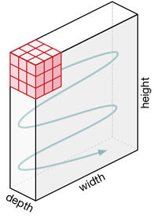
Convolutional Layer
32×32×3 Image
Width
weight mask
32
5×5×3 Filter
A single value
Height
32
the result of taking a dot product between the filter and a small 5x5x3 chunk of the image (i.e. 5*5*3 = 75-dimensional dot product + bias)
3
Depth
w^{T}.x + b

Slide 26
Convolutional Layer
Activation map
32×32×3 Image
Width
weight mask
32
28
5×5×3 Filter
Height
32
convolve (slide) over all spatial locations
28
3
Depth
1

Slide 27
Convolutional Layer
Handling multiple output maps
32×32×3 Image
Activation maps
Width
weight mask
32
28
5×5×3 Filter
Height
32
Second filter
28
3
Depth
1
1

Slide 28
Convolutional Layer
Handling multiple output maps
32×32×3 Image
Activation maps
Width
weight mask
32
28
5×5×3 Filter
Height
32
Third filter
28
3
Depth
1
1
1

Slide 29
Convolutional Layer
Handling multiple output maps
32×32×3 Image
Activation maps
Width
weight mask
32
28
5×5×3 Filter
Height
32
Total 96 filters
28
3
Depth
Depth of output volume: 96

Slide 30
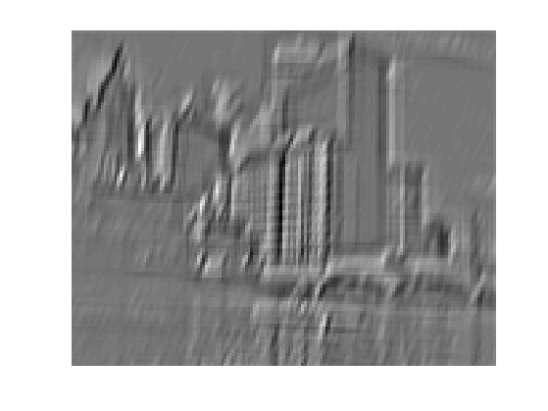
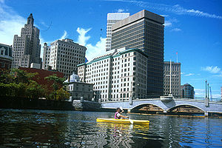
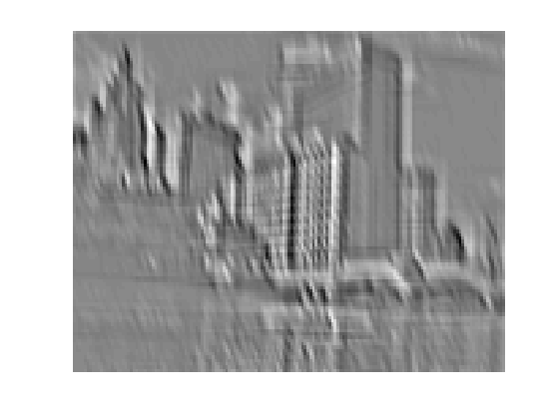
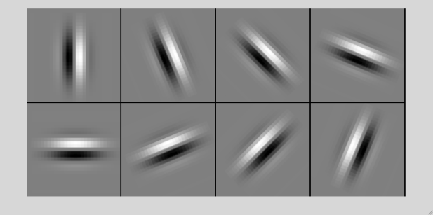
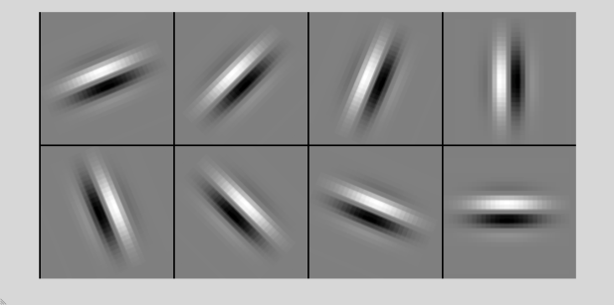

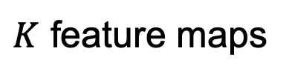
Convolution and traditional feature extraction
bank of $K$ filters
$K$ feature maps
...
image
feature map

Slide 31
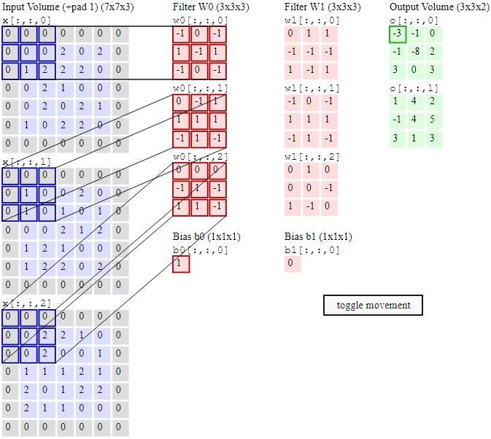
Image Source: cs231n, Oxford University

Slide 32
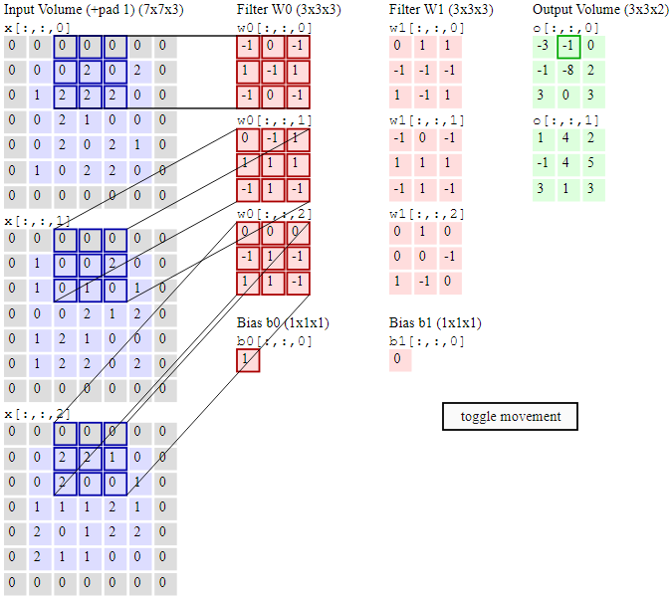
Image Source: cs231n, Oxford University

Slide 33
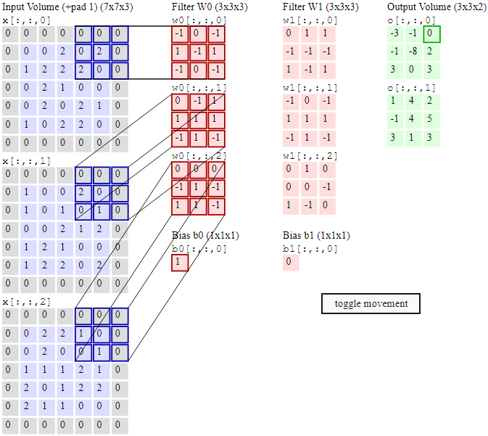
Image Source: cs231n, Oxford University

Slide 34
Convolutional Layer
Preview: ConvNet is a sequence of Convolution Layers, interspersed with activation functions
32×32×3 Image
Activation maps
32
28
32
CONV, e.g.
96 5x5x3 filters
28
3
96

Slide 35
Convolutional Layer
Preview: ConvNet is a sequence of Convolution Layers, interspersed with activation functions
32×32×3 Image
Activation maps
32
28
One
number
5×5×96
Filter
32
CONV, e.g.
96 5x5x3 filters
28
3
96

Slide 36
Convolutional Layer
Preview: ConvNet is a sequence of Convolution Layers, interspersed with activation functions
32×32×3 Image
Deeper activation
map
Activation maps
32
28
24
5×5×96
Filter
32
CONV, e.g.
96 5x5x3 filters
28
24
convolve (slide) over all spatial locations
3
96
1

Slide 37
Convolutional Layer
Preview: ConvNet is a sequence of Convolution Layers, interspersed with activation functions
32×32×3 Image
Deeper activation
maps
Activation maps
32
28
24
128
5×5×96
Filters
32
CONV, e.g.
96 5x5x3 filters
28
24
3
96
128

Slide 38
Multilayer Convolution
Preview: ConvNet is a sequence of Convolution Layers, interspersed with activation functions
. . .
CONV, e.g.
96 5x5x3 filters
CONV, e.g. 128 5x5x96 filters
CONV
32
28
24
32
28
24
3
96
128

Slide 39
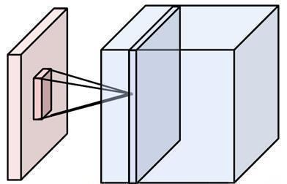
Any Convolution Layer
Local connectivity
Weight sharing
Handling multiple input channels
Handling multiple output maps
Weight sharing
Local connectivity
# input channels
# output (activation) maps
Image credit: A. Karpathy

Slide 40
A closer look at spatial dimensions
N
Output size
(N - F) / stride + 1
e.g. N = 7, F = 3
stride 1 => (7 - 3)/1 + 1 = 5
stride 2 => (7 - 3)/2 + 1 = 3
stride 3 => (7 - 3)/3 + 1 = 2.33
F
F
N

Slide 41
A closer look at spatial dimensions
. . .
CONV, e.g.
96 5x5x3 filters
CONV, e.g. 128 5x5x96 filters
CONV
32
28
24
32
28
24
3
96
128
E.g. 32x32 input convolved repeatedly with 5x5 filters shrinks volumes spatially!
(32 -> 28 -> 24 ...). Shrinking too fast is not good, doesn’t work well.
Source: cs231n, Stanford University

Slide 42
In practice: common to zero pad
0 | 0 | 0 | 0 | 0 | 0 | 0 | 0 | 0
0 |  |  |  |  |  |  |  | 0
0 |  |  |  |  |  |  |  | 0
0 |  |  |  |  |  |  |  | 0
0 |  |  |  |  |  |  |  | 0
0 |  |  |  |  |  |  |  | 0
0 |  |  |  |  |  |  |  | 0
0 |  |  |  |  |  |  |  | 0
0 | 0 | 0 | 0 | 0 | 0 | 0 | 0 | 0
e.g. input 7×7 (spatially)
3×3 filter, applied with stride 1
pad with 1 pixel border
7×7 Output
in general, common to see CONV layers with stride 1, filters of size F×F, and zero-padding with
(F-1)/2. (will preserve size spatially)
e.g.
F = 3 => zero pad with 1
F = 5 => zero pad with 2
F = 7 => zero pad with 3

Slide 43
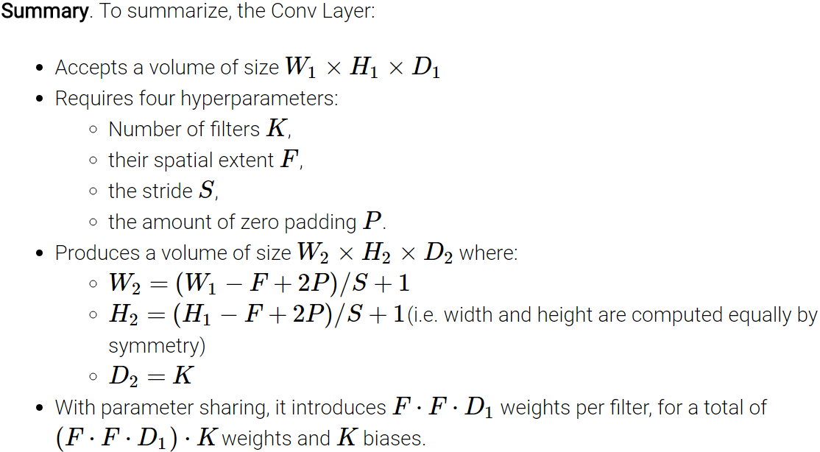
Source: cs231n, Stanford University

Slide 44

Pooling Layer
- makes the representations smaller and more manageable
- operates over each activation map independently:
Source: cs231n, Stanford University

Slide 45

Max Pooling
Backward pass: upstream gradient is passed back only to the unit with max value
Source: cs231n, Stanford University

Slide 46
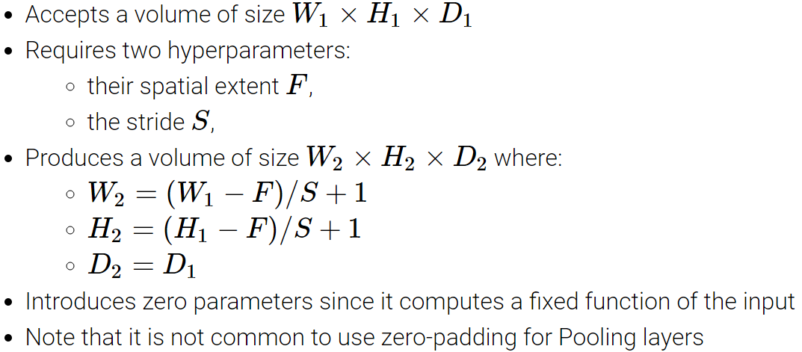
Pooling Layer
Source: cs231n, Stanford University

Slide 47
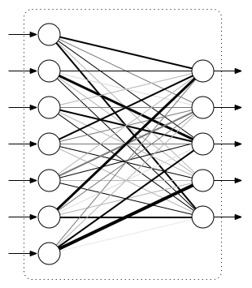
Fully Connected Layer
Connect every neuron in one layer to every neuron in another layer
Same as the traditional multi-layer perceptron neural network
Image Source: machinethink.net

Slide 48
Fully Connected Layer
Connect every neuron in one layer to every neuron in another layer
Same as the traditional multi-layer perceptron neural network
No. of Neurons (Last FC)
= No. of classes
Image Source: machinethink.net

Slide 49
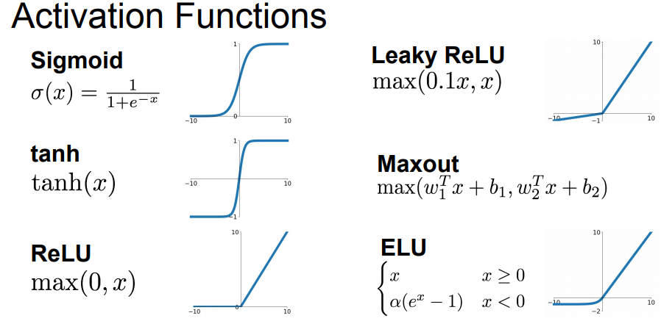
Non-linearity Layer
Source: cs231n, Stanford University

Slide 50
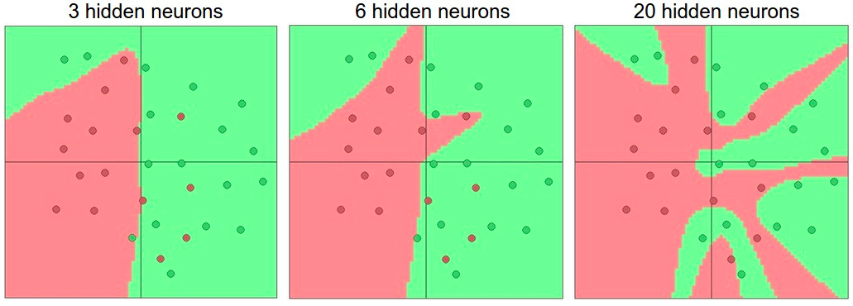
Activation Functions
Non-linearities needed to learn complex (non-linear) representations of data, otherwise the NN would be just a linear function
More layers and neurons can approximate more complex functions
http://cs231n.github.io/assets/nn1/layer_sizes.jpeg
Full list: https://en.wikipedia.org/wiki/Activation_function

Slide 51
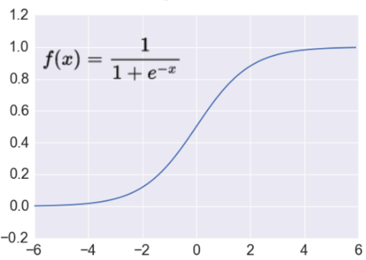
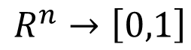
Activation Function: Sigmoid
Takes a real-valued number and “squashes” it into range between 0 and 1.
$$R^{n}→\left[0,1\right]$$
Nice interpretation as the firing rate of a neuron
0 = not firing at all
1 = fully firing
Sigmoid neurons saturate and kill gradients, thus NN will barely learn
when the neuron’s activation are 0 or 1 (saturate)
gradient at these regions almost zero
almost no signal will flow to its weights
if initial weights are too large then most neurons would saturate
http://adilmoujahid.com/images/activation.png

Slide 52
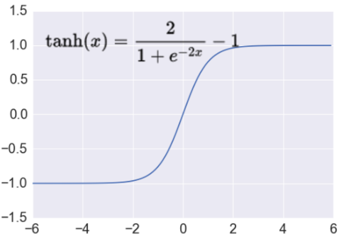
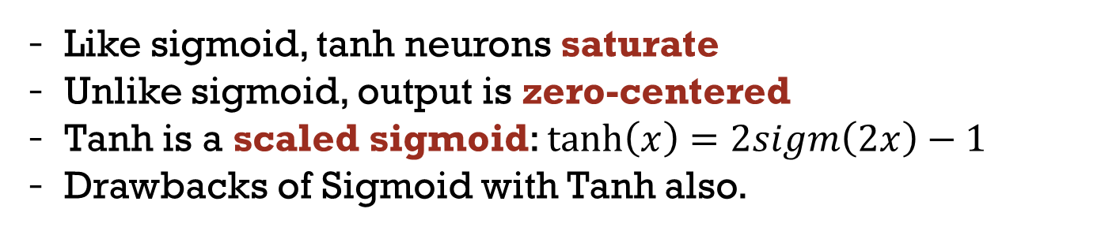
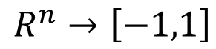
Activation Function: Tanh
Takes a real-valued number and “squashes” it into range between -1 and 1.
$$R^{n}→\left[−1,1\right]$$
Like sigmoid, tanh neurons saturate
Unlike sigmoid, output is zero-centered
Tanh is a scaled sigmoid: $\tanh\left(x\right)=2sigm\left(2x\right)−1$
Drawbacks of Sigmoid with Tanh also.
http://adilmoujahid.com/images/activation.png
Notes:
not zero-centered: later layers of processing would be receiving data that is not zero-centered.
if data coming into a neuron is always positive then the gradient on the weights will be either all be positive, or all negative (depending on the gradient of the whole expression). Could introduce undesirable zig-zagging dynamics in the gradient weight updates. However, once these gradients are added up across a data batch the final weight update can have variable signs, somewhat mitigating this issue.

Slide 53
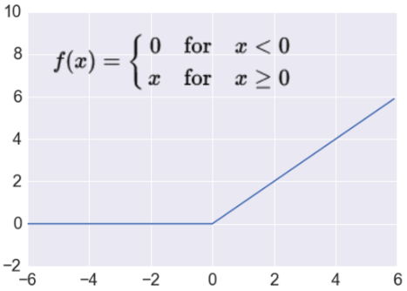
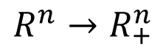
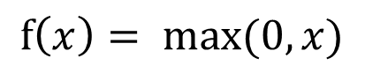
Activation Function: ReLU
Takes a real-valued number and thresholds it at zero
$$f\left(x\right)= max⁡(0,x)$$
$$R^{n}→R_{+}^{n}$$
Most Deep Networks use ReLU nowadays
Trains much faster
accelerates the convergence of SGD
due to linear, non-saturating form
Less expensive operations
compared to sigmoid/tanh (exponentials etc.)
implemented by simply thresholding a matrix at zero
More expressive
Prevents the gradient vanishing problem for +ive inputs
http://adilmoujahid.com/images/activation.png
Notes:
ReLU units can “die”
large gradient flowing through a ReLU could cause weights to update in such a way that the neuron will never activate on any datapoint again
gradient flowing through the unit will forever be zero from that point on
With a proper setting of the learning rate this is less frequently an issue

Slide 54
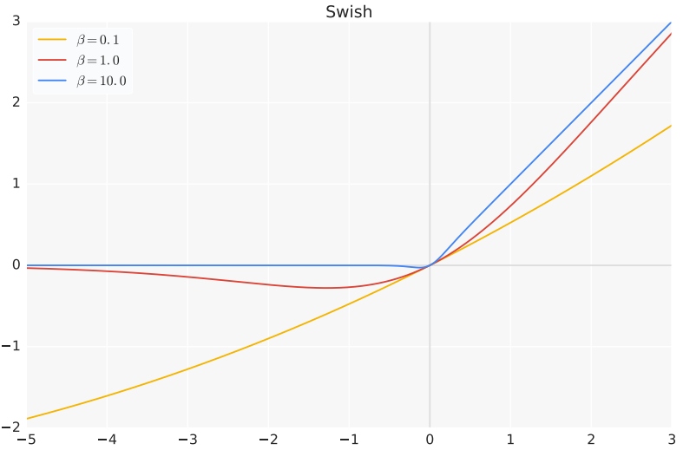
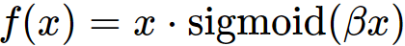
Activation Function: Swish
ReLU is special case of Swish
Ramachandran et al. "Swish: a self-gated activation function." ICLR Workshops, 2018.

Slide 55
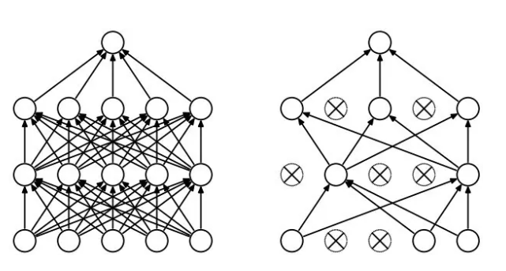
Regularization
Dropout
Randomly drop units (along with their connections) during training
Each unit retained with fixed probability p, independent of other units
Hyper-parameter p to be chosen (tuned)
Srivastava, Nitish, et al. "Dropout: a simple way to prevent neural networks from overfitting." Journal of machine learning research (2014)

Slide 56
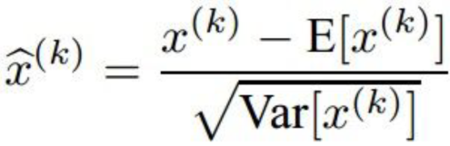
Batch Normalization
“We want zero-mean unit-variance activations? lets make them so.”
consider a batch of activations at some layer. To make
each dimension zero-mean unit-variance, apply:
Batch Normalization: Accelerating Deep Network Training by
Reducing Internal Covariate Shift [Ioffe and Szegedy 2015]
Source: cs231n

Slide 57
Classification/Loss Layer
SVM Classifier
SVM Loss/Hinge Loss/Max-margin Loss
Softmax Classifier
Softmax Loss/Cross-entropy Loss

Slide 58
Summary: CNN pipeline
Feature maps
Spatial pooling
Non-linearity
Convolution (Learned)
...
Input Image
Input
Feature Map
Source: R. Fergus, Y. LeCun

Slide 59
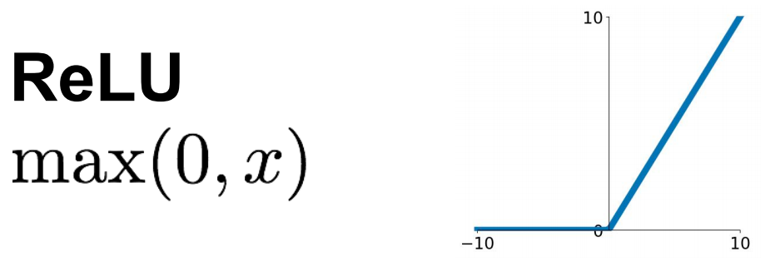
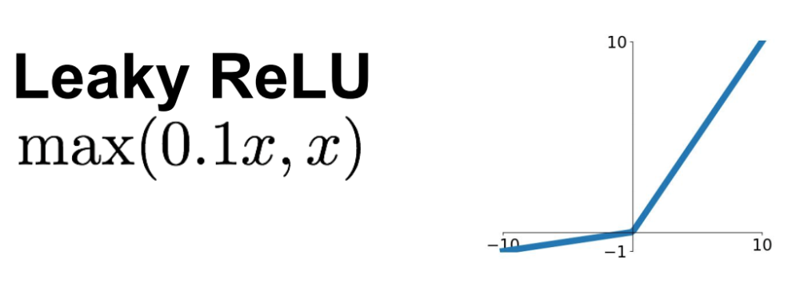
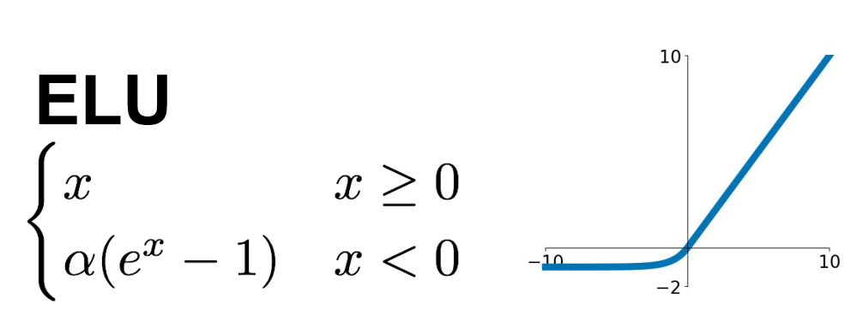
Summary: CNN pipeline
Feature maps
Spatial pooling
Non-linearity
Convolution (Learned)
Input Image
Source: R. Fergus, Y. LeCun
Source: Stanford 231n

Slide 60
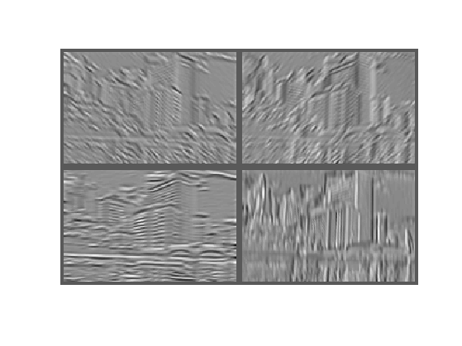
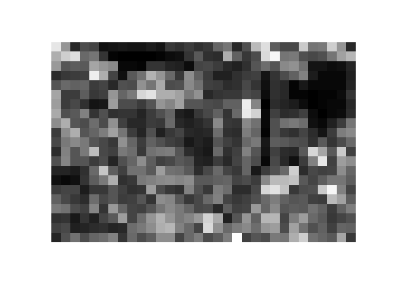
Summary: CNN pipeline
Feature maps
Max (or Avg)
Spatial pooling
Non-linearity
Convolution (Learned)
Input Image
Source: R. Fergus, Y. LeCun

Slide 61

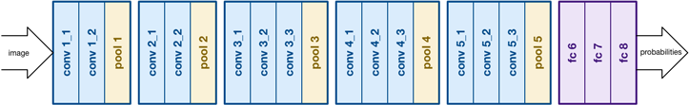
Summary: CNN pipeline
Softmax layer:

Slide 62
ImageNet Challenge
~14 million labeled images, 20k classes
Images gathered from Internet
Human labels via Amazon MTurk
Challenge: 1.2 million training images, 1000 classes
www.image-net.org/challenges/LSVRC/

Slide 63
ImageNet Challenge
GPUs
+
Data
~14 million labeled images, 20k classes
Images gathered from Internet
Human labels via Amazon MTurk
Challenge: 1.2 million training images, 1000 classes
www.image-net.org/challenges/LSVRC/

Slide 64
Progress on ImageNet Challenge

Slide 65
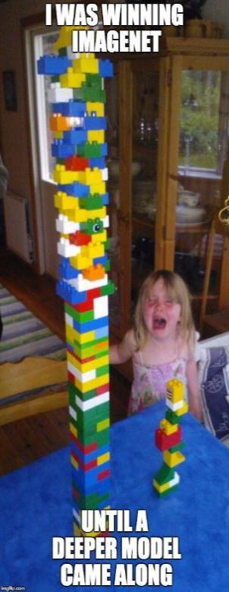
Progress on ImageNet Challenge
Best Non-ConvNet in 2012: 26.2%

Slide 66
CNN Architectures FOR CLASSIFICATION

Slide 67
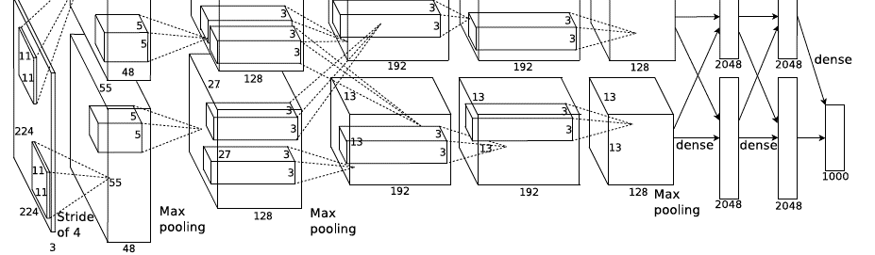
AlexNet
Full (simplified) AlexNet architecture:
[227x227x3] INPUT
[55x55x96] CONV1: 96 11x11 filters at stride 4, pad 0
[27x27x96] MAX POOL1: 3x3 filters at stride 2
[27x27x96] NORM1: Normalization layer
[27x27x256] CONV2: 256 5x5 filters at stride 1, pad 2
[13x13x256] MAX POOL2: 3x3 filters at stride 2
[13x13x256] NORM2: Normalization layer
[13x13x384] CONV3: 384 3x3 filters at stride 1, pad 1
[13x13x384] CONV4: 384 3x3 filters at stride 1, pad 1
[13x13x256] CONV5: 256 3x3 filters at stride 1, pad 1
[6x6x256] MAX POOL3: 3x3 filters at stride 2
[4096] FC6: 4096 neurons
[4096] FC7: 4096 neurons
[1000] FC8: 1000 neurons (class scores)
Details/Retrospectives:
- first use of ReLU
- used Norm layers (not common anymore)
- heavy data augmentation
- batch size 128
- SGD Momentum 0.9
- Learning rate 0.01, reduced manually when val accuracy saturates
Krizhevsky, et al. Imagenet classification with deep convolutional neural networks. NIPS 2012.
Source: cs231n

Slide 68

VGGNet
Small filters, Deeper networks
8 layers (AlexNet)
-> 16 - 19 layers (VGGNet)
Only 3x3 CONV stride 1, pad 1
and 2x2 MAX POOL stride 2
VGG16 (source)
Simonyan et al. Very deep convolutional networks for large-scale image recognition. ICLR2015.

Slide 69
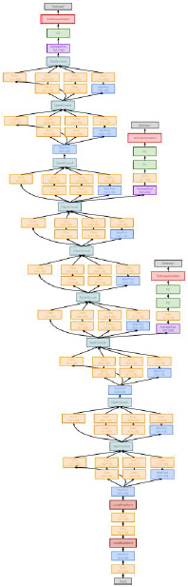
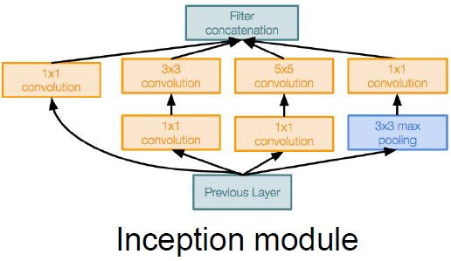
GoogLeNet
“Inception module”:
design a good local network topology and then stack these modules on top of each other
Szegedy, Christian, et al. "Going deeper with convolutions." CVPR 2015.
Source: cs231n

Slide 70
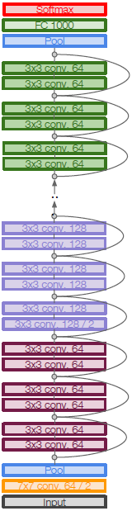
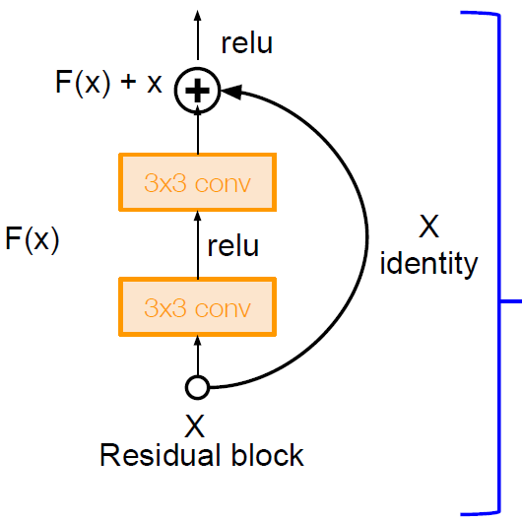
ResNet
No FC layers
besides FC
1000 to output
Classes
Global average
pooling layer
after last
conv layer
Full ResNet architecture:
Stack residual blocks
Residual block has two 3x3 conv layers
Periodically, double # of filters and downsample spatially using stride 2 (/2 in each dimension)
Additional conv layer at the beginning
No FC layers at the end (only FC 1000 to output classes)
3x3 conv, 128 filters, /2 spatially with stride 2
3x3 conv, 64 filters
Beginning
conv layer
He et al. Deep Residual Learning for Image Recognition, IEEE CVPR 2016.
Source: cs231n

Slide 71
CNN Architectures FOR OBJECT RECOGNITION

Slide 72
R-CNN: Region proposals + CNN features
Source: R. Girshick
SVMs
Classify regions with SVMs
SVMs
ConvNet
SVMs
ConvNet
Forward each region through ConvNet
ConvNet
Warped image regions
Region proposals
Input image
R. Girshick, J. Donahue, T. Darrell, and J. Malik, Rich Feature Hierarchies for Accurate Object Detection and Semantic Segmentation, CVPR 2014
Notes:
The features are also sent to a linear regressor that improves object localization.
The components outlined in purple are “post hoc” in the sense that they are learned after the convnet weights are trained and forever frozen.

Slide 73
Fast R-CNN (Girshick ICCV 2015)
Softmax classifier
softmax
Linear
Bounding-box regressors
FCs
Fully-connected layers
“RoI Pooling” layer
Region proposals
“conv5” feature map of image
ConvNet
Forward whole image through ConvNet
https://arxiv.org/pdf/1504.08083.pdf

Slide 74

One network, four losses
Faster R-CNN (Ren et al. NIPS 2015)
Classification loss
Bounding-box regression loss
…
Classification loss
Bounding-box regression loss
RoI pooling
proposals
Region Proposal Network
feature map
CNN
Source: R. Girshick, K. He
image

Slide 75
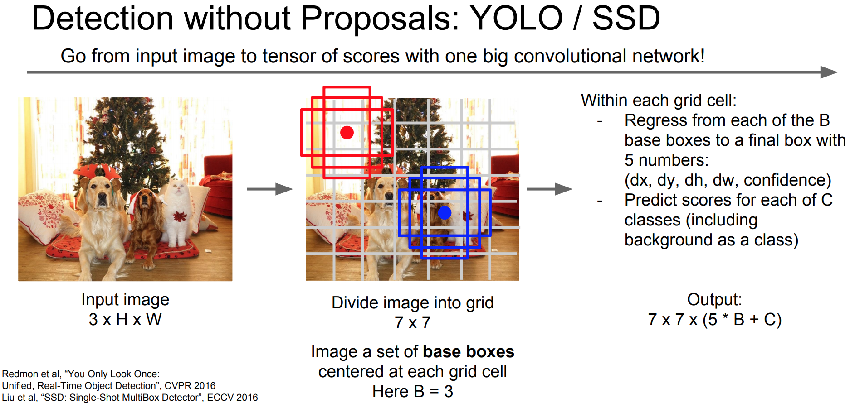
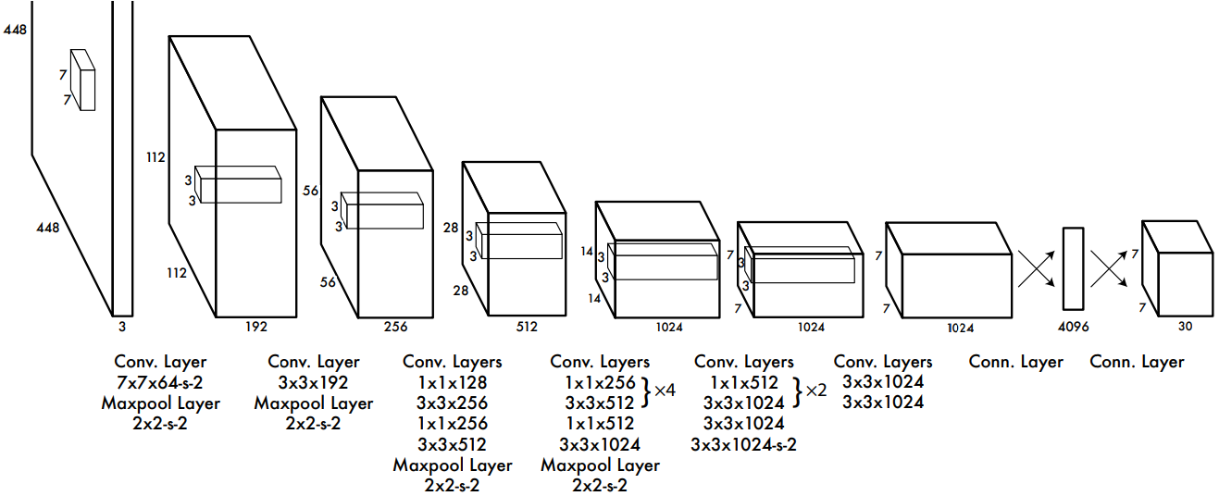
You Only Look Once (YOLO)
Very efficient but lower accuracy
Redmon et al. You only look once: Unified, real-time object detection. CVPR 2016.
Notes:
Most cited paper in NIPS 2015.

Slide 76
CNN Architectures FOR SEGMENTATION

Slide 77
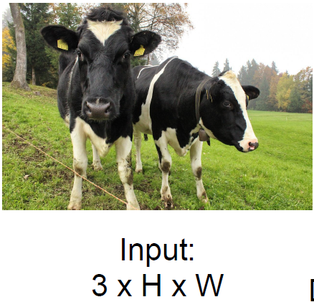
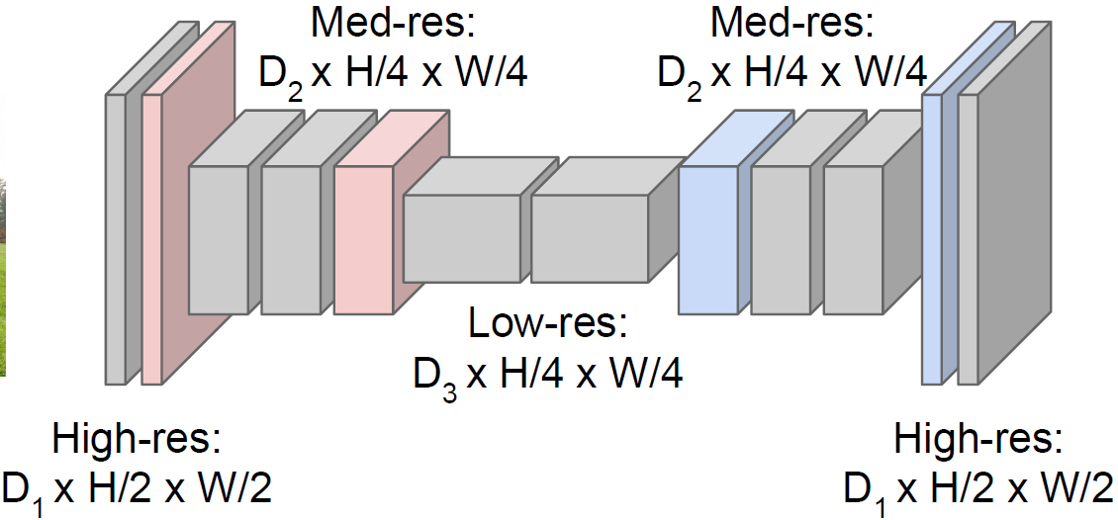
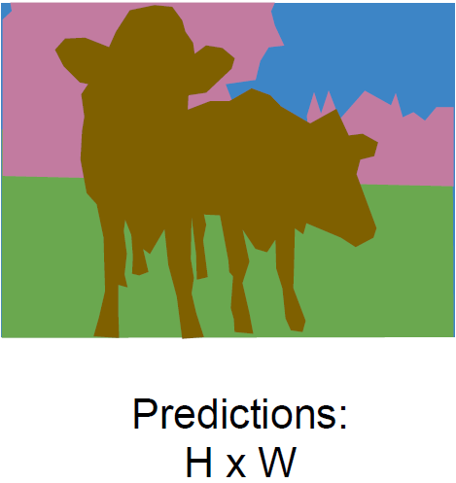
Semantic Segmentation: Fully Convolutional
Downsampling:
Pooling, strided
convolution
Design network as a bunch of convolutional layers, with downsampling and upsampling inside the network!
Upsampling:
Unpooling or strided transpose convolution
Long et al. Fully Convolutional Networks for Semantic Segmentation, CVPR 2015
Noh et al. Learning Deconvolution Network for Semantic Segmentation, ICCV 2015
Slide credit: cs231n

Slide 78
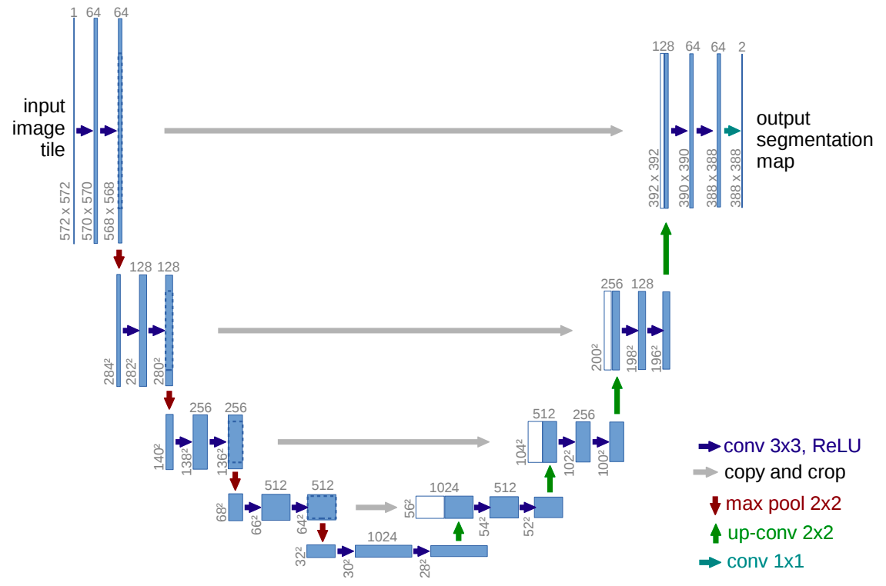
U-Net
O. Ronneberger, P. Fischer, T. Brox U-Net: Convolutional Networks for Biomedical Image Segmentation, MICCAI 2015

Slide 79
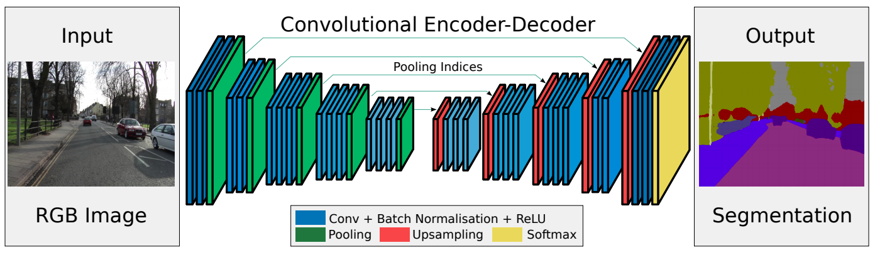
SegNet
Drop the FC layers, get better results
V. Badrinarayanan, A. Kendall and R. Cipolla, SegNet: A Deep Convolutional Encoder-Decoder Architecture for Image Segmentation, PAMI 2017

Slide 80
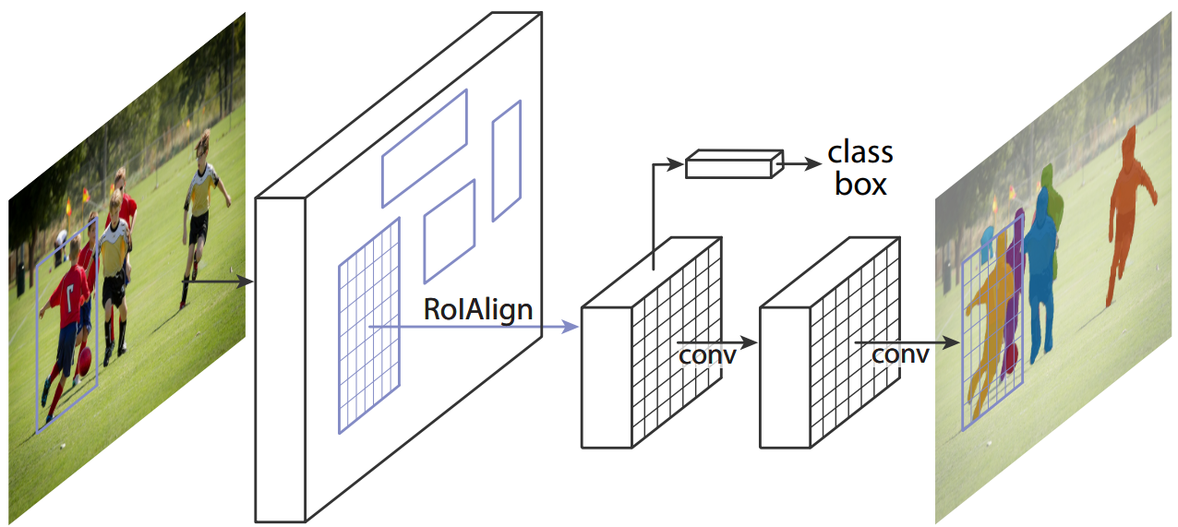
Instance Segmentation: Mask R-CNN (He et al. ICCV 2017)
Classification Scores: C
Box coordinates (per class): 4 * C
Mask R-CNN - extends Faster R-CNN by adding a branch for predicting an object mask in parallel with the existing branch for bounding box recognition.
Mask R-CNN is simple to train and adds only a small overhead to Faster R-CNN, running at 5 fps.
He et al. Mask R-CNN, ICCV 2017. https://arxiv.org/pdf/1703.06870.pdf
Notes:
Most cited paper in NIPS 2015.

Slide 81
CNN Architectures FOR GENERATIVE TASKS

Slide 82
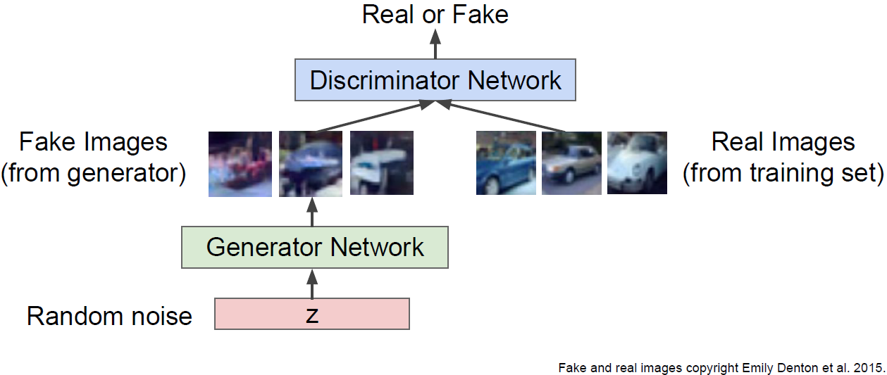
Generative adversarial networks
Ian Goodfellow et al., “Generative Adversarial Nets”, NIPS 2014
Fake and real images copyright Emily Denton et al. 2015.
Credit: cs231n, Stanford

Slide 83

Image-to-image translation: Pix2Pix
Image-to-image translation: Pix2Pix

Slide 84


Image-to-Image Translation: Cycle GAN
https://hardikbansal.github.io/CycleGANBlog/

Slide 85
Acknowledgement
Thanks to the following courses and corresponding researchers for making their teaching/research material online
Convolutional Neural Networks for Visual Recognition, Stanford University
Deep Learning, Stanford University
Introduction to Deep Learning, University of Illinois at Urbana-Champaign
Introduction to Deep Learning, Carnegie Mellon University
Natural Language Processing with Deep Learning, Stanford University
Ismini Lourentzou
UIUC
And Many More Publicly Available Resources ......

Slide 86

Thank you
QUESTIONS?
Image Source: http://pluspng.com/best-of-luck-png-5072.html

